Slide 1
Developing a Credit Scoring AI-enabled Model with Azure Databricks
Bucharest ai NIGHT
Bucharest · September 5, 2019
#BucharestAINight
#GlobalAINight
Laurentiu Diaconu, Data Enablement Consultant, Softelligence

Slide 2

Setup: https://aka.ms/ai-night-bucharest

Slide 3

Introduction to Credit Scoring
Credit scoring is a statistical analysis performed by lenders and financial institutions to access a person's creditworthiness.
This is used to determine a person’s ability to borrow money for mortgages, auto loans and even private loans for college.
Key points:
VantageScore and FICO are both popular credit-scoring models (these models estimate a score between 0 and 1000)
Credit rankings apply to companies (business) and governments and credit scoring applies to individuals
A credit score is influenced by the following categories:
Payment history
Types of credit
New credit
Current debt
Length of credit

Slide 4

Introduction to Credit Scoring (cont’d)
A person needs to pay special attention to current debt and payment history.
Limitations:
Although credit scoring ranks a borrower's credit riskiness, it does not provide an estimate of a borrower's default probability. As an ordinal ranking, it only assesses a borrower's riskiness from highest to lowest. As such, credit scoring suffers from its inability to determine whether Borrower A is twice as risky as Borrower B.
Another interesting limit to credit scoring is its inability to explicitly factor in current economic conditions. For instance, if Borrower A has a credit score of 800 and the economy enters a recession, Borrower A's credit score would not adjust unless Borrower A's behavior of financial position changed.
Credit Scoring models don’t usually take into account other information about the individuals (e.g. demographics) or about the context which could very well influence the probability of default

Slide 5

Probability of… default?
Default probability is the likelihood over a specified period, usually one year, that a borrower will not be able to make the scheduled repayments.
Default probability, or probability of default (PD), depends not only on the borrower's characteristics but also on the economic environment. For consumers, a FICO score implies a particular probability of default. For businesses, a probability is implied by their credit rating. PDs may also be estimated using historical data and statistical techniques.
Generally, the higher the default probability, the higher the interest rate the lender will charge the borrower. Creditors typically want a higher interest rate to compensate for bearing higher default risk.

Slide 6


The Problem
Your mission is to improve on the state of the art in credit scoring by predicting the probability that somebody will experience financial distress in the next 2 years.
This challenge was initially published on Kaggle (GiveMeSomeCredit).
Information provided:
150k observations which you can use for Training
102k observations which you can use to benchmark your model against real unseen data

Slide 7
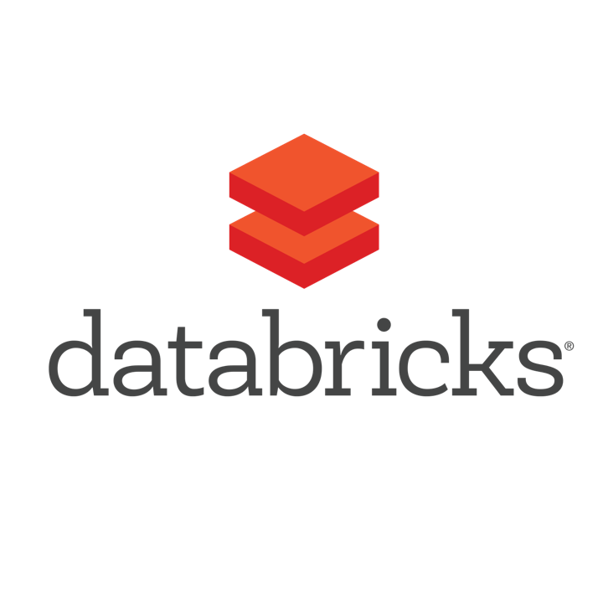
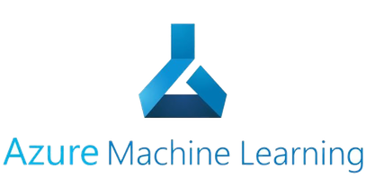
What tools and/or services are we going to use?
Azure Databricks
Fast, easy and collaborative Apache SparkTM–based analytics service
https://azure.microsoft.com/en-in/services/databricks/
Azure Machine Learning Service
Build models rapidly and operationalise at scale from cloud to edge
https://azure.microsoft.com/en-in/services/machine-learning-service/

Slide 8
Quick Overview
Azure Databricks

Slide 9
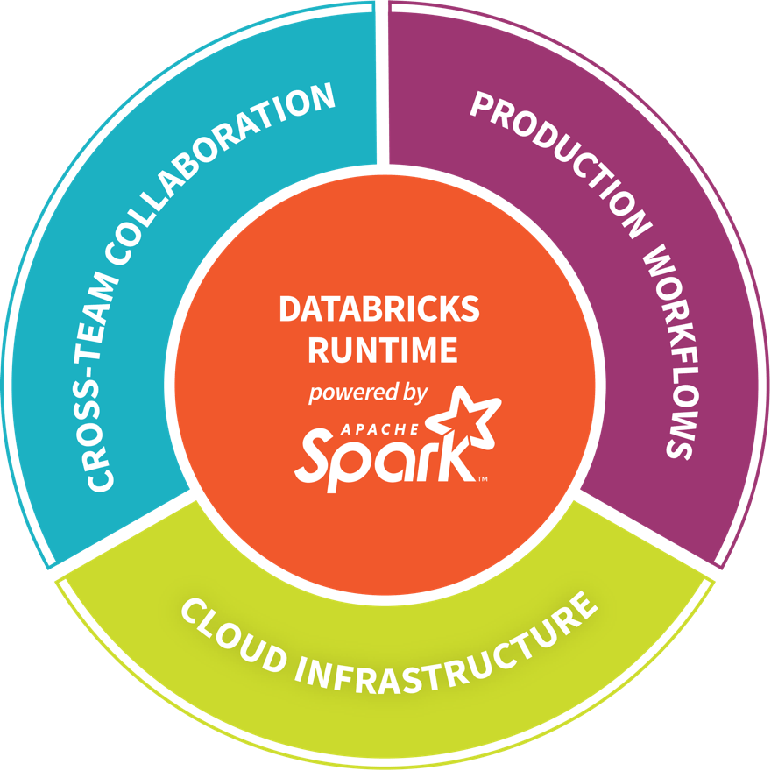
The Company
Founded in late 2013, by the creators of Apache Spark, original team from UC Berkeley AMPLab
Largest code contributor code to Apache Spark
Level 2/3 support partnership with:
Hortonworks
MapR
DataStax
Provides certifications such as Databricks Certified Application, Databricks Certified Distribution and Databricks Certified Developer
Main Product: The Unified Analytics Platform
In Oct 2017, introduced Databricks Delta (currently in private preview).

Slide 10
But what is Apache Spark?
Spark Unifies:
Batch Processing
Interactive SQL
Real-time processing
Machine Learning
Deep Learning
Graph Processing
Spark SQL
Interactive Queries
Spark MLlib
Machine Learning
Spark Streaming
Stream processing
GraphX
Graph Computation
Spark Core Engine
Yarn
Mesos
Standalone Scheduler
Spark MLlib
Machine Learning
Spark Structured Streaming
Stream processing

Slide 11



So what can you do with it?
Azure Databricks
Collaborative Workspace
IoT / streaming data
Machine learning models
DATA ENGINEER
DATA SCIENTIST
BUSINESS ANALYST
Deploy Production Jobs & Workflows
Cloud storage
BI tools
MULTI-STAGE PIPELINES
JOB SCHEDULER
NOTIFICATION & LOGS
Data warehouses
Optimized Databricks Runtime Engine
Data exports
Hadoop storage
DATABRICKS I/O
APACHE SPARK
SERVERLESS
Rest APIs
Data warehouses
Enhance Productivity
Build on secure & trusted cloud
Scale without limits

Slide 12
Core Concepts
Azure Databricks

Slide 13
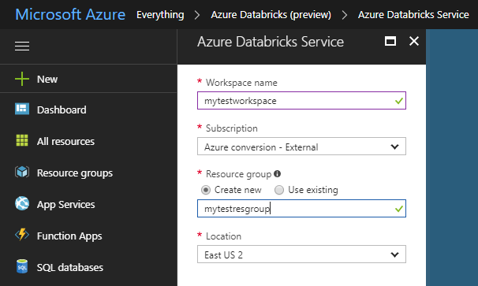
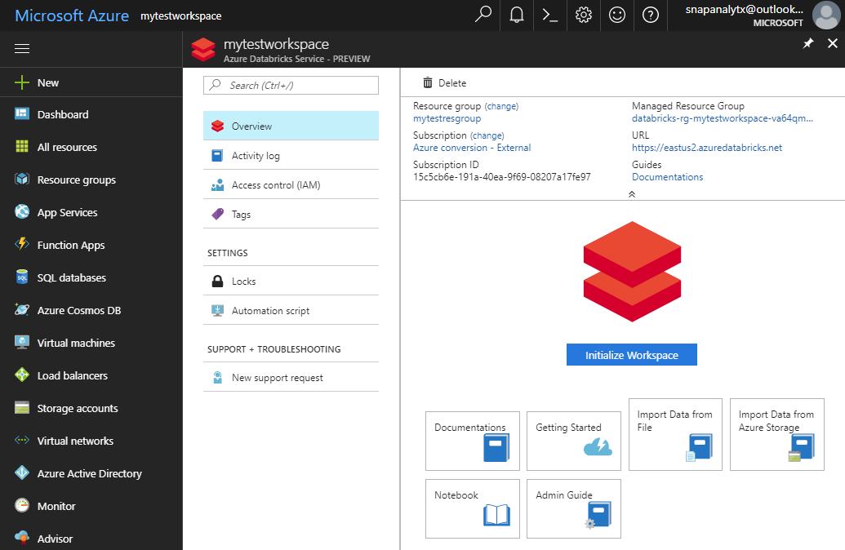
Provisioning Azure Databricks Workspace
Azure Databricks is provisioned directly from the Azure Portal like any other Azure service.
In contrast, with other clouds, it has to be provisioned through the Databricks portal.
With Azure Databricks, the Azure Portal offers a unified portal to provision and administer Azure Databricks as well as other Azure services.
Any Azure user with the appropriate subscription and authorization can provision Azure Databricks service*.
There is no need for a separate Databricks account
Provisioning the Azure Databricks Service
After provisioning the is complete

Slide 14
General Spark Architecture
‘Driver’ runs the user’s ‘main’ function and executes the various parallel operations on the worker nodes.
The results of the operations are collected by the driver
The worker nodes read and write data from/to Data Sources including HDFS.
Worker node also cache transformed data in memory as RDDs (Resilient Data Sets).
Worker nodes and the Driver Node execute as VMs in public clouds (AWS, Google and Azure).
Driver Program SparkContext
Cluster Manager
Worker Node
Worker Node
Worker Node
Cache
Cache
Cache
Task
Task
Task
Data Sources (HDFS, SQL, NoSQL, …)

Slide 15
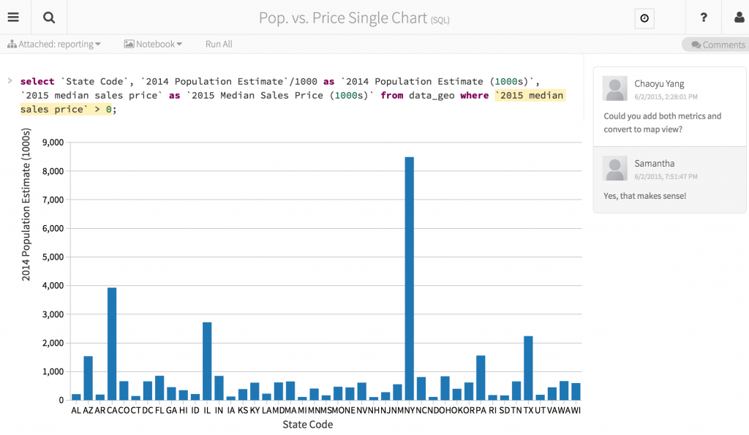
Azure Databricks Notebooks Overview
Notebooks are a popular way to develop, and run, Spark Applications.
Notebooks are not only for authoring Spark applications but can be run/executed directly on clusters
Shift+Enter
click the at the top right of the cell in a notebook
Submit via Job
Notebooks support fine grained permissions—so they can be securely shared with colleagues for collaboration (see following slide for details on permissions and abilities)
Notebooks are well-suited for prototyping, rapid development, exploration, discovery and iterative development
Notebooks typically consist of code, data, visualization, comments and notes

Slide 16
Mixing Programming Languages in Notebooks
You can mix multiple languages in the same notebook.
Normally a notebook is associated with a specific language. However, with Azure Databricks notebooks, you can mix multiple languages in the same notebook. This is done using the language magic command:
%python Allows you to execute python code in a notebook (even if that notebook is not python).
%sql Allows you to execute sql code in a notebook (even if that notebook is not sql).
%r Allows you to execute r code in a notebook (even if that notebook is not r).
%scala Allows you to execute scala code in a notebook (even if that notebook is not scala).
%sh Allows you to execute shell code in your notebook.
%fs Allows you to use Databricks Utilities - dbutils filesystem commands.
%md To include rendered markdown

Slide 17
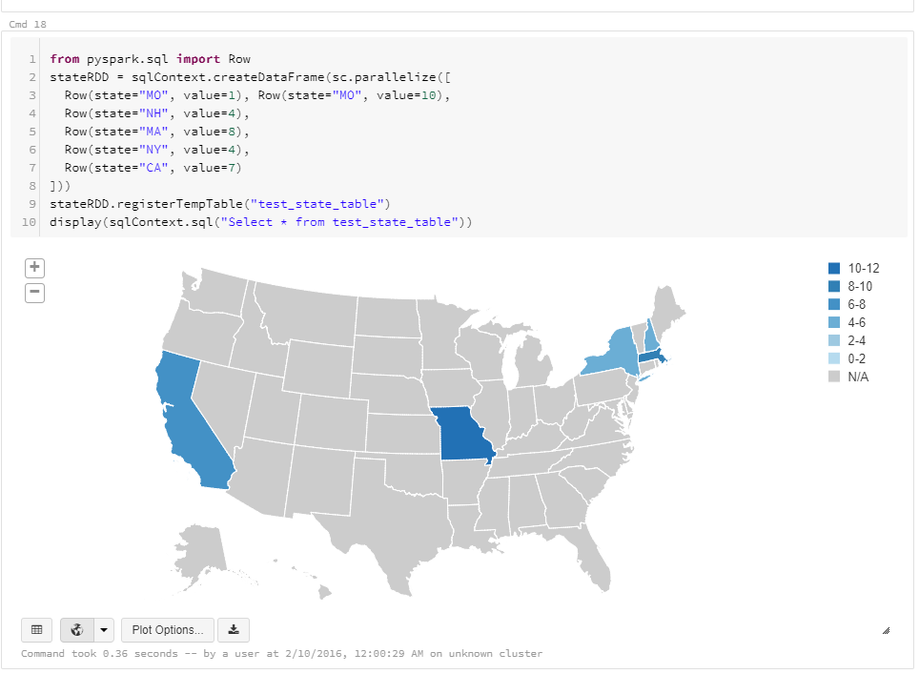
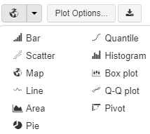
Visualization
Azure Databricks supports a number of visualization plots out of the box.
All notebooks, regardless of their language, support Databricks visualizations.
When you run the notebook the visualizations are rendered inside the notebook in-place
The visualizations are written in HTML:
You can save the HTML of the entire notebook by exporting to HTML;
If you use Matplotlib, the plots are rendered as images so you can just right click and download the image;
You can change the plot type just by picking from the selection:

Slide 18
Quick Overview
Azure ML Service

Slide 19
What is Azure Machine Learning Service?
Set of Azure Cloud Services
Python SDK
That enables you to:
Prepare Data
Build Models
Train Models
Manage Models
Track Experiments
Deploy Models

Slide 20
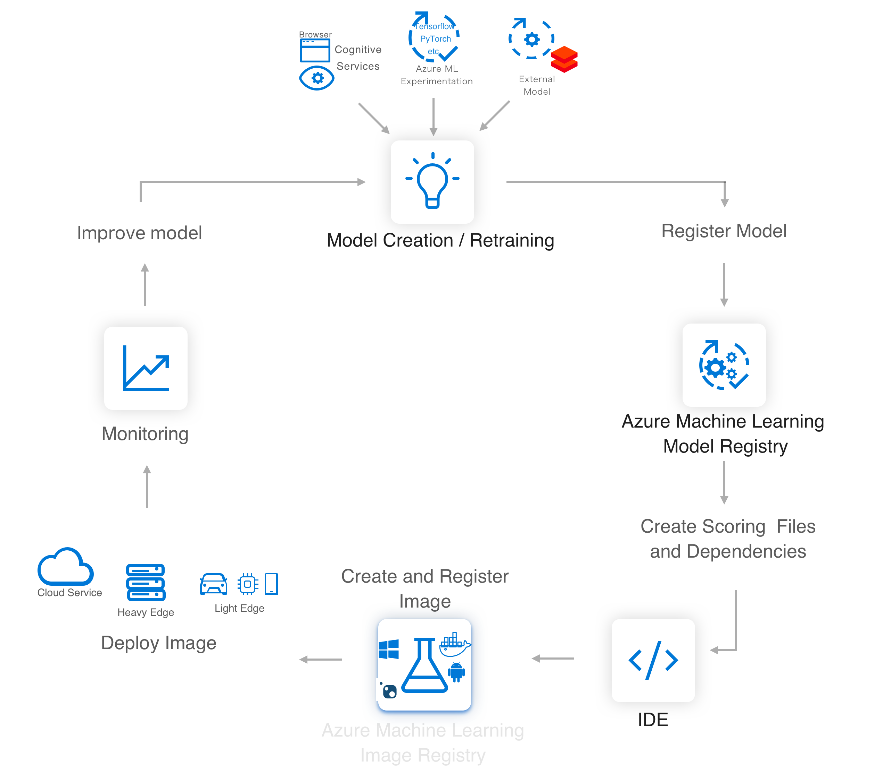
Implement the AI/ML lifecycle easily with Azure ML Service
Workflow Steps
Develop machine learning training scripts in Python.
Create and configure a compute target.
Submit the scripts to the configured compute target to run in that environment. During training, the compute target stores run records to a datastore. There the records are saved to an experiment.
Query the experiment for logged metrics from the current and past runs. If the metrics do not indicate a desired outcome, loop back to step 1 and iterate on your scripts.
Once a satisfactory run is found, register the persisted model in the model registry.
Develop a scoring script.
Create an Image and register it in the image registry.
Deploy the image as a web service in Azure.

Slide 21
Key Artifacts
Workspace
Models
Images
Experiments
Deployment
Pipelines
Data Stores
Compute Target

Slide 22
Azure Automated Machine Learning ‘simplifies’ the creation and selection of the optimal model.

Slide 23
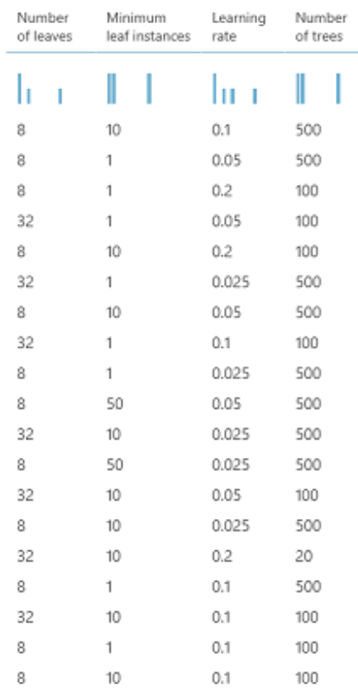
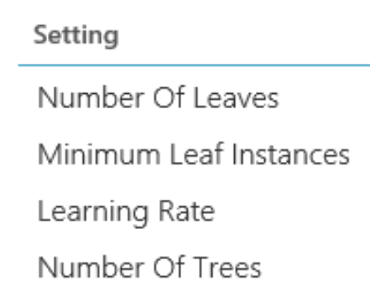
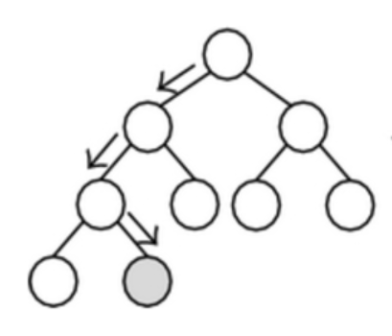
What are Hyperparameters?
Adjustable parameters that govern model training;
Chosen prior to training, stay constant during training;
Model performance heavily depends on hyperparameters.

Slide 24

Typical ‘manual’ approach to hyperparameter tuning
Complex
Tedious
Repetitive
Time consuming
Expensive
Dataset
Model Training
Infrastructure
Training Algorithm 1
Training Algorithm 2
Model 1
Model 2
Model 3
Model 4
Hyperparameter
Values – config 1
Hyperparameter
Values – config 2
Hyperparameter
Values – config 3
Hyperparameter
Values – config 4

Slide 25

Challenges with Hyperparameter Selection
The search space to explore — i.e. evaluating all possible combinations — is huge.
Sparsity of good configurations. Very few of all possible configurations are optimal.
Evaluating each configuration is resource and time consuming.
Time and resources are limited.

Slide 26
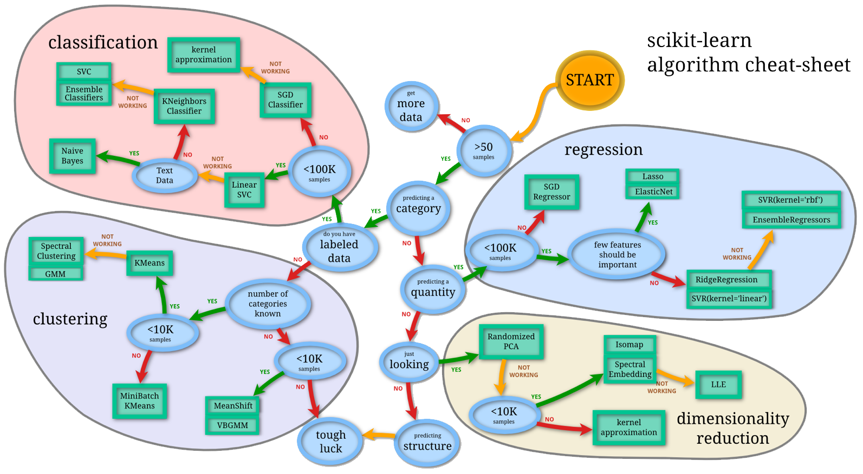
Complexity of Machine Learning
Source: http://scikit-learn.org/stable/tutorial/machine_learning_map/index.html

Slide 27
Automated Machine Learning
Conceptual Overview
Automated ML Tuning Specifications
Hyperparameter ranges
Optimization metric
Early Termination Policy
Budget – Time / Compute
# parallel runs
High Quality ML Model
Inputs
Azure Automated ML
Recommended hyperparameter configuration
Run metrics
Training script
+
Training data

Slide 28
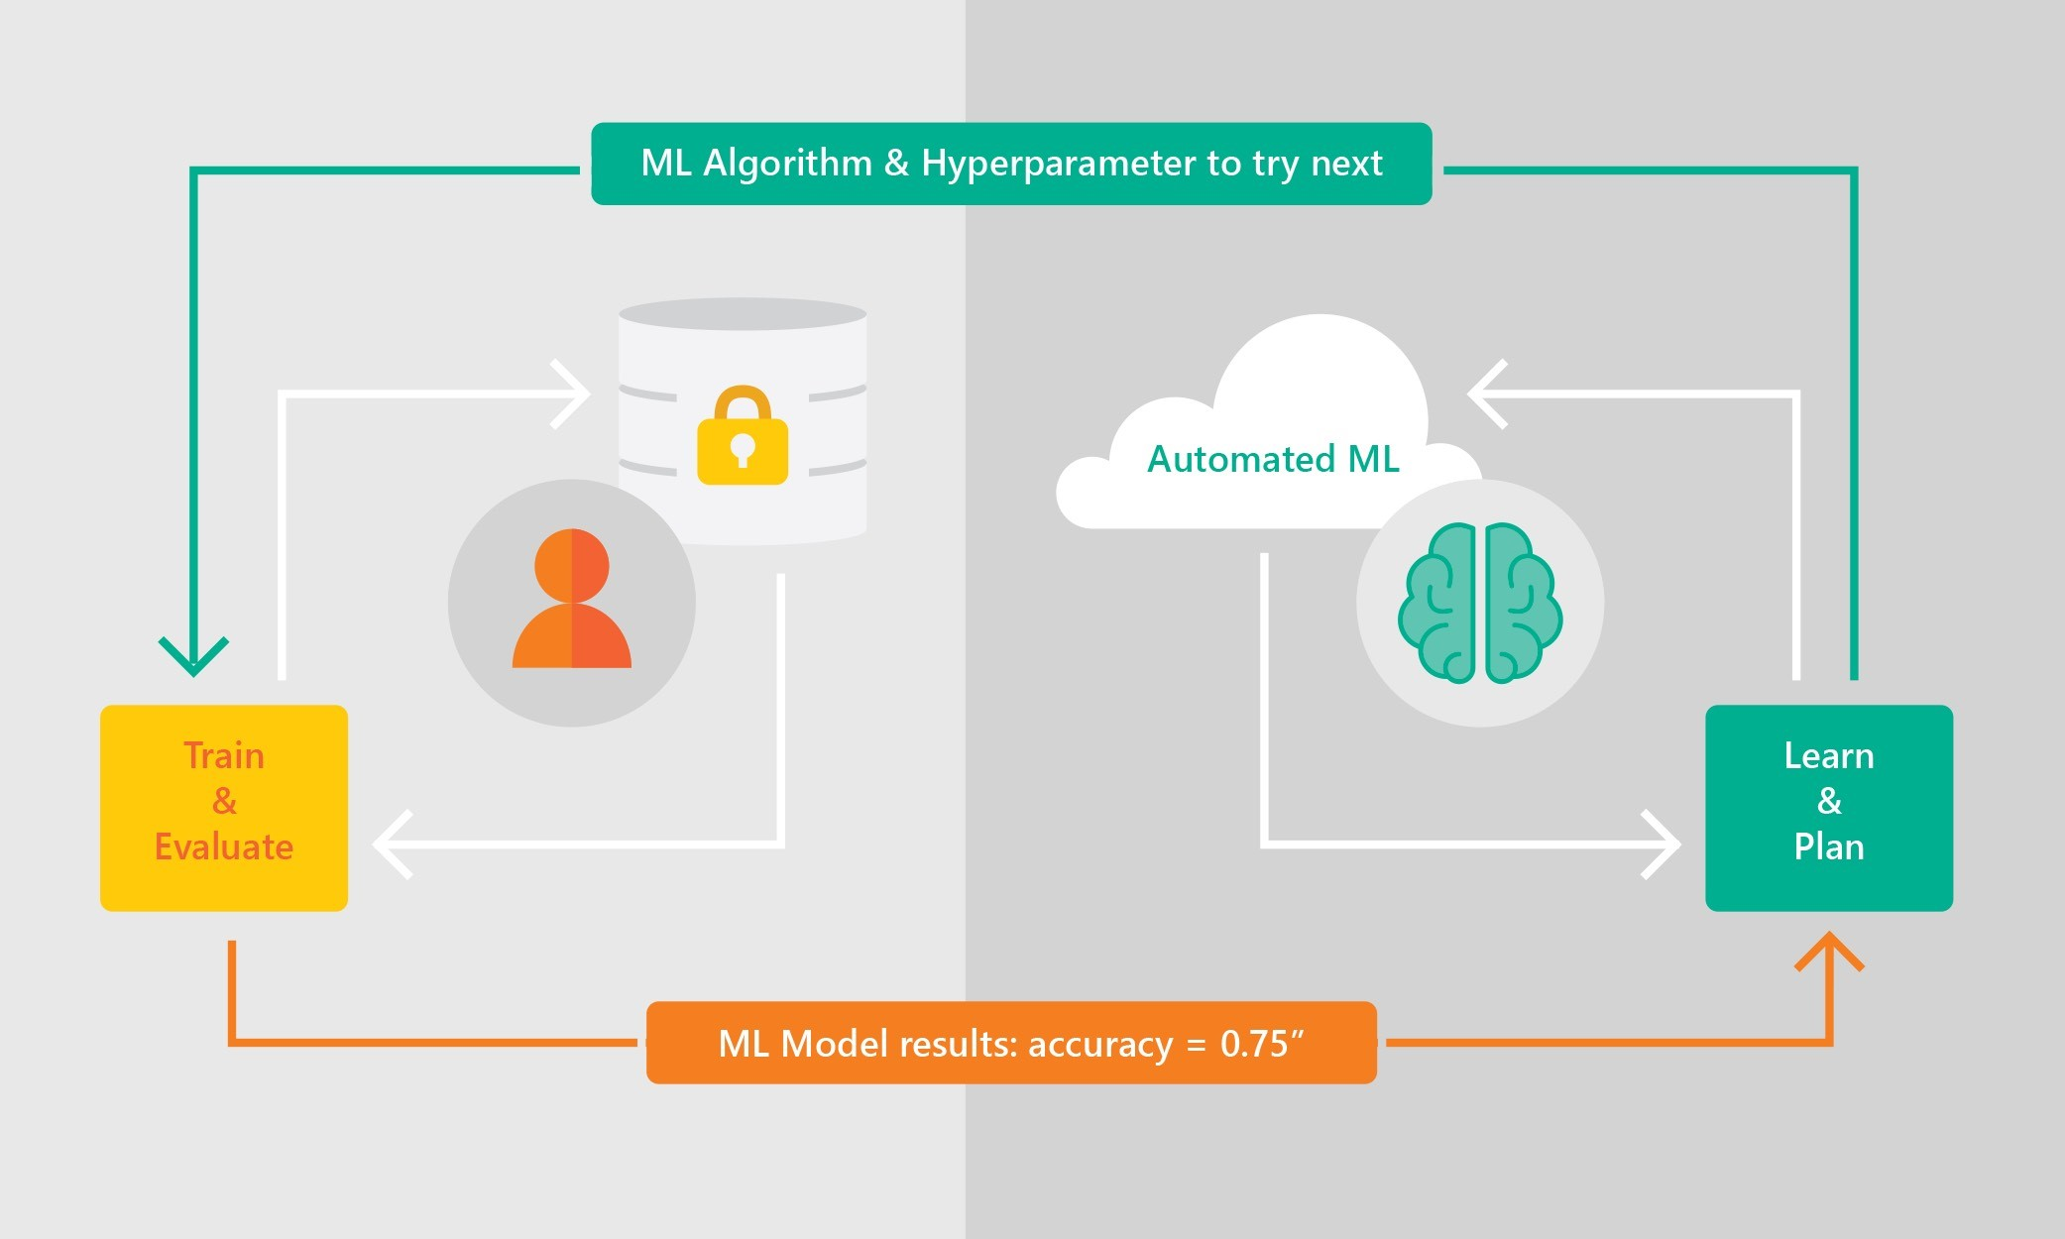
Automated Machine Learning
Benefits Overview
Azure Automated ML lets you:
Automate the exploration process
Use resources more efficiently
Optimize model for desired outcome
Control resource budget
Apply it to different models and learning domains
Pick training frameworks of choice
Visualize all configurations in one place

Slide 29
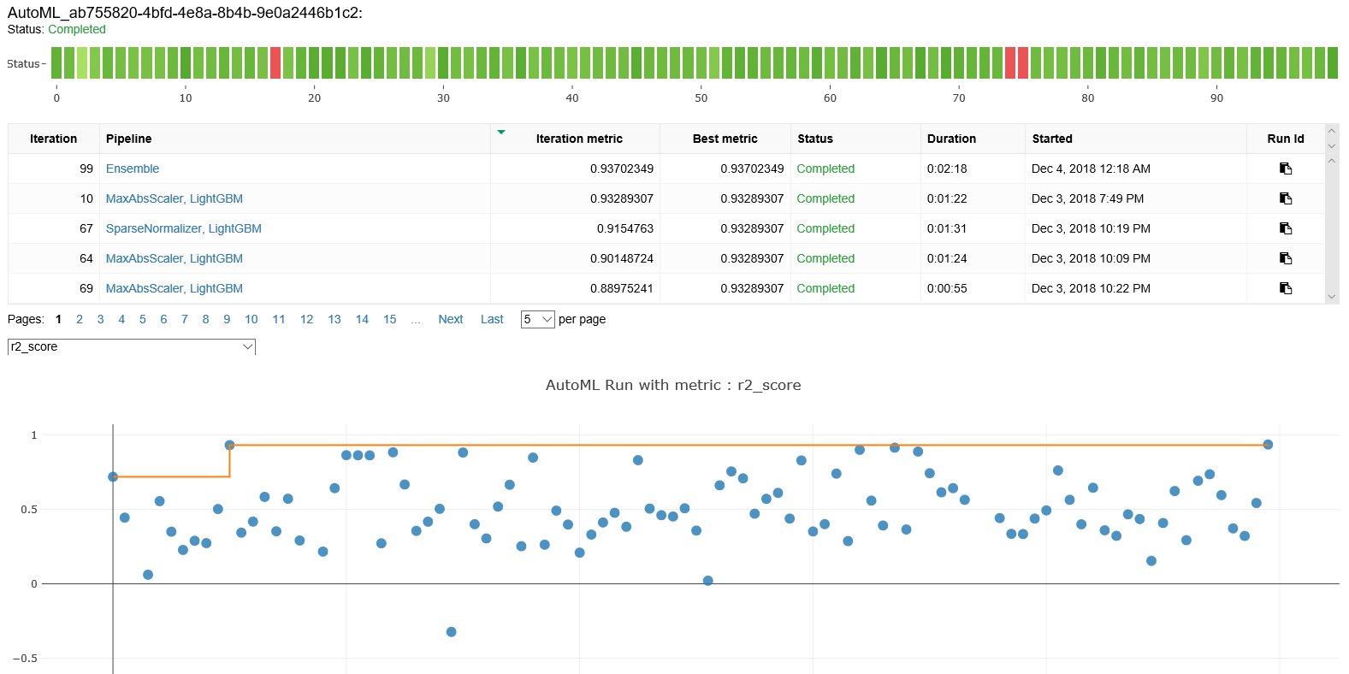
Azure Automated ML – sample output

Slide 30
Let’s play

Slide 31
Challenge Details
Create an Azure Databricks Notebook in which you go through the following steps (as showcased in the following demo):
01 | Import training data | 05 | Model training with AutoML
02 | Exploratory data analysis | 06 | Use trained model to predict on real unseen data
03 | Data cleaning | 07 | Evaluate model performance on real unseen data
04 | Feature engineering

Slide 32
Resources
Resource | Description | From | Note
Account to access an Azure Databricks workspace with permissions on Azure ML Service | You will use this to connect to an Azure Databricks workspace and to view AutoML runs in Azure ML Service | Sent | Each of you has one account
Training data | This data should be used for exploratory data analysis, cleaning, feature engineering and model training | https://raw.githubusercontent.com/dlawrences/GlobalAINightBucharest/master/data/cs-training.csv | Use this link in your notebook to download the file
Real unseen data | This data should be used for the final model evaluation on real unseen data | https://raw.githubusercontent.com/dlawrences/GlobalAINightBucharest/master/data/cs-test.csv | Use this link in your notebook to download the file
Guided notebook | This notebook contains a full solution to your challenge | https://github.com/dlawrences/GlobalAINightBucharest/blob/master/notebooks/Global%20AI%20Night%20-%20Credit%20Scoring.py | Use this link to import the notebook in Databricks
Azure Databricks Documentation | For your reference | https://docs.microsoft.com/en-us/azure/azure-databricks/ | Spark-level info is included in the next docs
Apache Spark as per the Python API | For your reference | https://spark.apache.org/docs/latest/api/python/index.html
Azure ML SDK Documentation for Python | For your reference | https://docs.microsoft.com/en-us/python/api/overview/azure/ml/intro?view=azure-ml-py

Slide 33
See it at work

Slide 34
Debriefing

Slide 35


Thanks for attending!
Reach out to me:
laurentiu.diaconu@softelligence.net
/laurentiudiaconu

